Slide 1
Image Steganography
Manoel JMJN

Slide 2
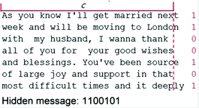
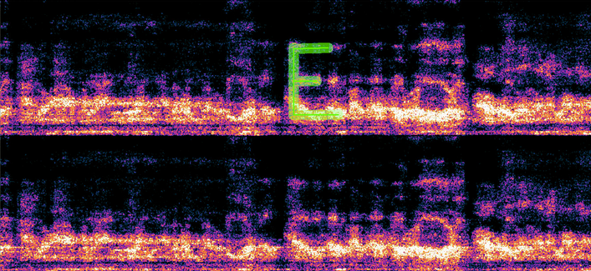
What is Steganography?
Steganography is the practice of hiding a secret message in something that is not secret.
There are many different forms of stenography in the digital world:
Image
Video
Audio
Text
I will be focusing on Image Steganography; specifically,
one version of it: Hiding another image inside of an image.

Slide 3


My Program: Overview / Purpose
Used to hide an image inside of another image
My program is designed to hide an image inside another image by changing the least significant bit in the Red Green and Blue values of a pixel in an image with values, either to make an 8 bit black and white image or a 9 bit color image (3 bits per color channel).
To explain how this works, I will be using the images below:

Slide 4

How BW Mode Works:
1) The image to be hidden is turned into a monochrome image.
2) The image is centered over the image to be hidden
Value of this pixel is Value of this pixel is
10010101
RED GREEN BLUE
00000000 00000000 00000000
00000010 00000010 00000100
Original New
00000000

Slide 5

RESULT:

Slide 6

To get the original image back, simply undo everything done above, and you get something like this.
Time for a Demo!

Slide 7



How Color Mode Works:
Color mode works much the same way as Black and White mode does
RED GREEN BLUE
00000000 10010101 11110000
10010010 11010000 01010000
NEW COLOR
RED GREEN BLUE
10010000 11010100 01010111

Slide 8
Shown Image
Hidden Image
Original Color
Color with Encoded Color
Original Color
After Decoding

Slide 9

RESULT:

Slide 10

To get the original image back, simply bit shift the last 3 bits of red, green, and blue to the front
Time for a Demo!

Slide 11
Limitations
The brighter the image that you're hiding the other image in is, the more visible the hidden image is (when it shouldn't be)
This is visible on the encoded examples above.
Using darker images (where the eye can see less detail) can help mitigate this.
This process loses detail when used (either B&W or limited color)
=/=

Slide 12
Why Use this?
Obfuscation: people can't intercept what they don’t know exists.
Security: Even if people do know it exists, you can use this in conjunction with other methods (such as hiding a QR code leading to a string of numbers you have to decode before getting the actual message)

Slide 13
REFRENCES
- https://www.geeksforgeeks.org/early-evidence-of-steganography
- https://konstantinnovation.github.io/cyber.html
- https://en.wikipedia.org/wiki/List_of_monochrome_and_RGB_color_formats
https://forum.audacityteam.org/t/steganography/64990

